Slide 1

CREDIT CARD APPROVAL
SYSTEM
By – Ahimsa Jain(CSIT) Akshat Sethiya(CSE)

Slide 2

Problem Statement
Commercial banks receive a lot of applications for credit cards. Many of them get rejected for many reasons, like high loan balances, low income levels, or too many inquiries on an individual's credit report. Manually analyzing these applications is error-prone, and time-consuming .Luckily, this task can be automated with the power of machine learning . In this notebook, we will build an automatic credit card approval predictor using machine learning techniques, just like the real banks do.

Slide 3

IMPORTANCE OF PROJECT
● Credit card approval can very helpful for organisations that lend credit cards and due to increase in huge number of applicant there is need to automate the task and classify the applicants into if they are eligible for credit card or not.
● This helps to avoid organisation losses by avoiding potential defaulters.
● Here we are not just looking into bank balance but into their personal attributes like gender,married,age,occupation etc. We account for these personal attributes to evaluate if given is applicant is good customer.
● This gives benefit by cutting down costs on credit analysis and faster credit decisions.

Slide 4
Data Source
The Data Set we have obtained from Google . The data contains various variables such as Gender, Age, Education, Employed...

Slide 5
Data Analysis and Pre-processing
The data set contains 690 instances of 16 variable.
Which are Gender, Age, Debt, Married, Bank Customer, Education, Ethnicity, Years Employed, Prior Default, Employed, Credit Score, Driving License, Citizenship, Zip Code, Income, Approved.
Approved is the label of the instance consisting + or - denoting whether the credit card request approved or not.

Slide 6
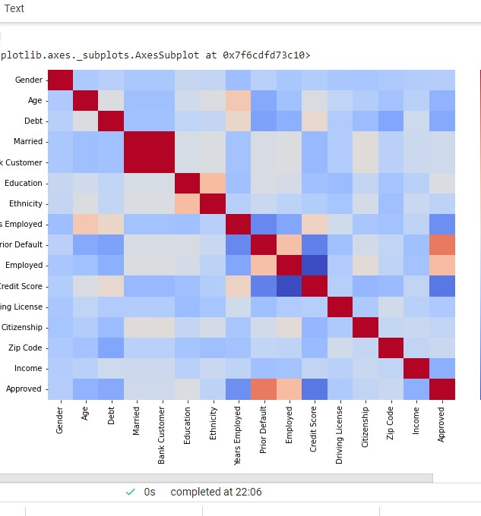
Correlation Matrix
The correlation matrix tells us that some features like Married, Gender,Citizenship does not play any important role in the credit card approval.
We can simply drop these attributes.

Slide 7
Model Selection
03
Because the output is classification type so we can’t use Linear Regression here, but can use Decision Tree Classifier, Logistic Regression

Slide 8
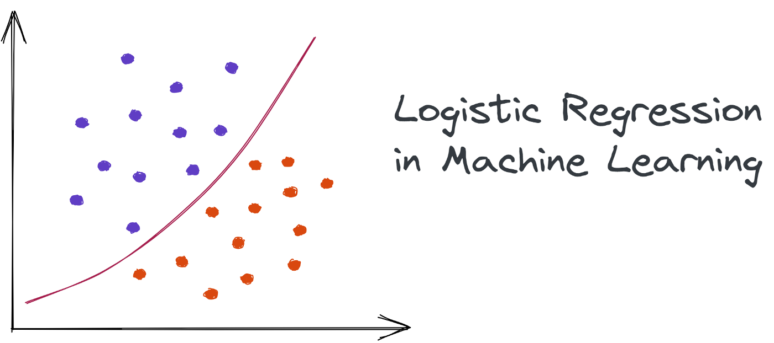
What is logistic regression?
Logistic regression is an example of supervised learning. It is used to calculate or predict the probability of a binary (yes/no) event occurring.

Slide 9
What is Decision Tree Classification ?
It is a representation for getting all the possible solutions to a problem/decision based on given conditions.

Slide 10
Thank
You

